Slide 1


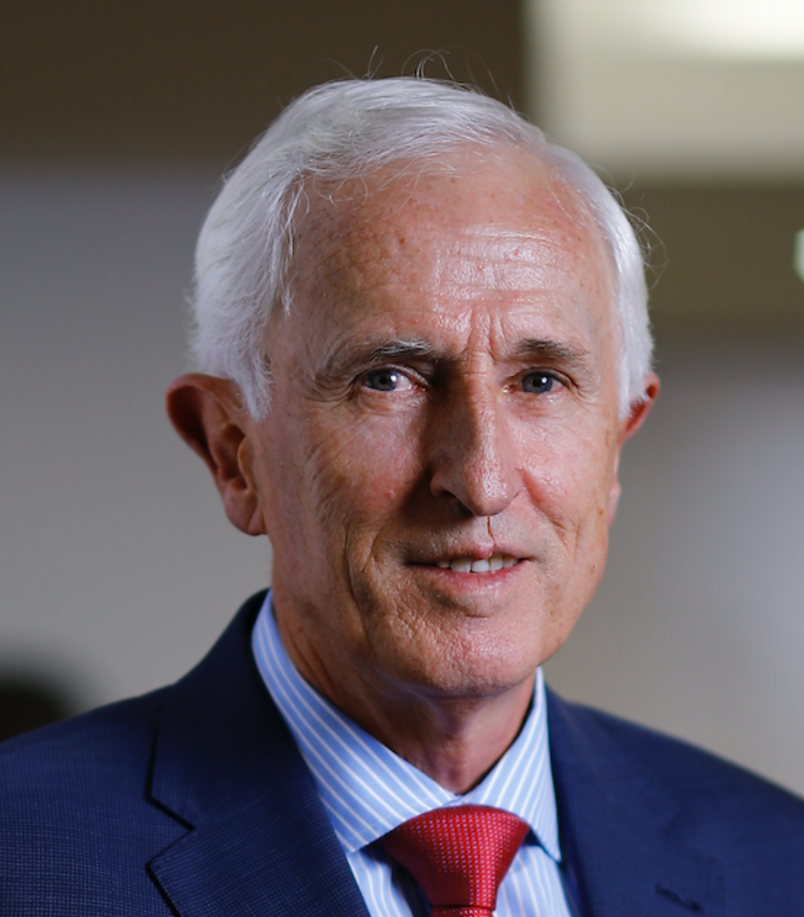
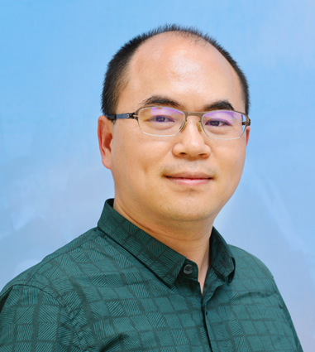


SAVE
THE
DATE
Nov 15th 2022, 4-5 P.M. SST
Diagnosing Asthma – New Approaches to an Old Problem: Guidelines, Tools and Treatments
Prof. Eric Bateman & Prof. Gang Wang
E-503549 151120222 RESPI SYM Global Webinar Prof . Eric Bateman & Prof. Gang Wang
KEY TOPICS:
Emeritus Prof. Eric Bateman is a pulmonologist and clinician scientist, founder and director of the University of Cape Town Lung Institute (1999 until 2016) and former Head of the Division of Pulmonology at the UCT and Groote Schuur Hospital, Cape Town (from 1989 until 2012). He has an A-rating from the National Research Foundation of South Africa ,is a Life Fellow of the UCT, a founding Fellow of the European Respiratory Society, a member of the Board and Science Committee of the Global Initiative for Asthma. Eric is lead author for one of the SABINA multi-country publications.
Understand the current challenges in asthma diagnosis and the consequence of over or under-diagnosis of asthma
Review latest recommendations from key guidelines on asthma diagnosis
Discuss practical tips in improving asthma diagnosis and asthma management
Prof. Gang Wang is a professor and associate director of the Department of Respiratory and Critical Care Medicine and the Szechuan Respiratory Disease Clinical Research Center of the West China School of Medicine / West China Hospital, Chengdu, China. He is also a committee member of the Asthma Association of Chinese Thoracic Society, Chinese Medical Association (CMA), member of the CHEST Expert Cough Panel (APCC), editorial board of the Journal of Thoracic Disease, Journal of Inflammation and the European Respiratory Journal Open Research. He has published over 60 papers in key international journals and participates in 22 projects in the National Natural Science Foundation of China.
Please scan QR codes or key in links to register & access webinar:
https://webstreamlive.com/astrazeneca/global/session1/15112022/
*Accreditation of CME points for this event is pending SMC approval.
SMC will accreditate 1 CME/CPE point for a 1 hr webcast.
SMC may require AstraZeneca to share the record of the duration of video view by each respective HCP.
Under the endorsement of:
For Healthcare Professionals only
This event is organized and funded by AstraZeneca

